Slide 1
Big Mountain Resort Ticket Pricing Strategy
A Data-Driven Business Strategy Proposal
Lee Stetson

Slide 2
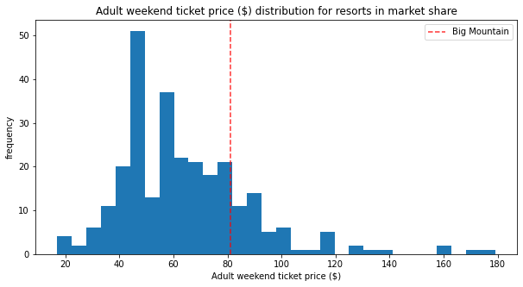
What is the Problem?
New chair lift installation will result in $1.54 million in additional operating costs each year
Current pricing model simply adds an arbitrary premium to the market average
Profits may not be maximized based on the current capabilities of Big Mountain Resort
The pricing impact of further site developments cannot be predicted

Slide 3
Problem Statement
How can Big Mountain Resort reduce operational costs and/or increase ticket price (revenue) so that profits increase by at least $3 million by the end of the year?
Scope:
Focus mainly on ticket price by analysing the market for typical pricing
Methods of cost reduction will be considered based on resort specifications
Parameters outside of the scope of the provided dataset will not be considered at this time
Constraints:
An increase in ticket price will not guarantee increased revenue as consumers may not be willing to pay the new price
It may be difficult to predict the impact on costs due to the scope of the provided dataset
Additional data on operational costs may be necessary
Data provided:
CSV File from Alesha Eisen (Database Manager) containing site data and pricing for over 300 resorts

Slide 4
Proposal Overview
Model suggested weekend ticket price: $95.87
Up from $81 for ~$26 million annual revenue increase
Bottom prediction of $85.48
Most valuable assets:
# of FastQuads, # of Runs, Snow Making area, maximum vertical drop
Most profitable renovations:
One additional run
150 ft additional vertical drop
One additional chair lift
Scenario | Ticket Price ($) | Additional Annual Revenue* ($ million)
Current | 81.00 | -
Proposed Increase (no renovation) | 95.87 | 26.0
Renovations | 97.86 | 29.5
*Revenue based on projected 350,000 annual visits and 5-day average ticket

Slide 5
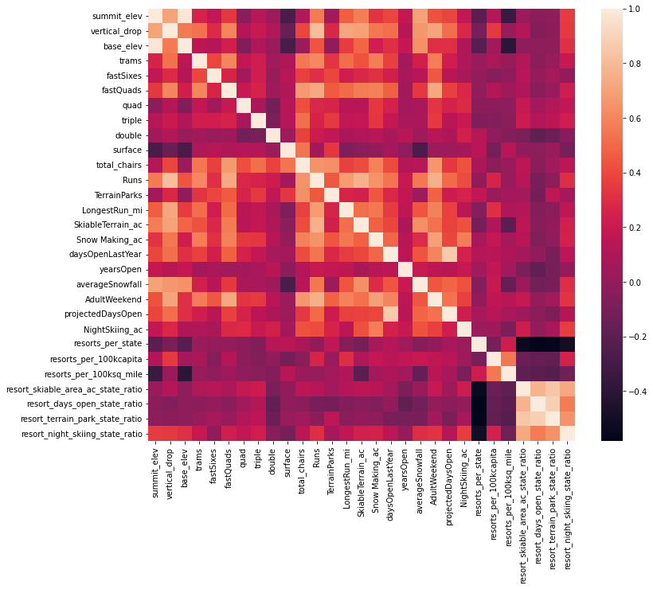
Data Wrangling & Exploratory Data Analysis
Data that could be inferred (obvious data entry error) was filled
Data that could not be inferred was dropped
Resorts missing all price data was dropped
State data (total area & population) added
Only weekend prices were included
AdultWeekend >= AdultWeekday in all cases
Values equal in many cases
Valuable features include:
fastQuad, Runs, Snow Making_ac, vertical_drop, total_chairs, resort_night_skiing_state_ratio
Target feature

Slide 6
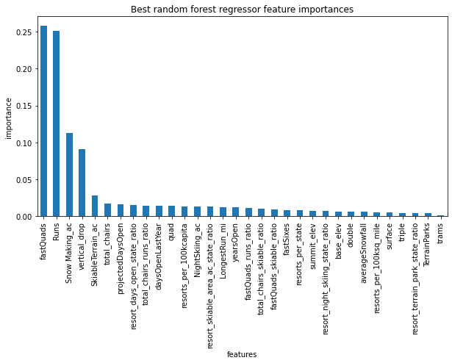
Preprocessing & Model Development
Considered linear regression model & random forest model
Considered imputing missing data with mean or median
Considered scaling data to mean zero and unit variance
Best Linear Model:
K-best features: 8
CV Mean absolute error: $10.499
Best Random Forest Model:
N-estimators: 69
CV Mean absolute error: $9.645

Slide 7
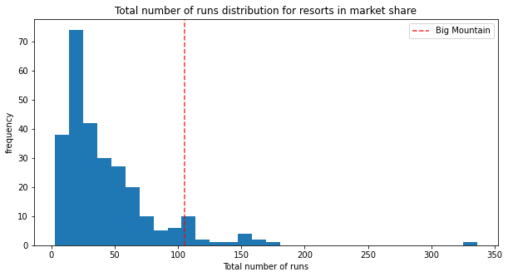
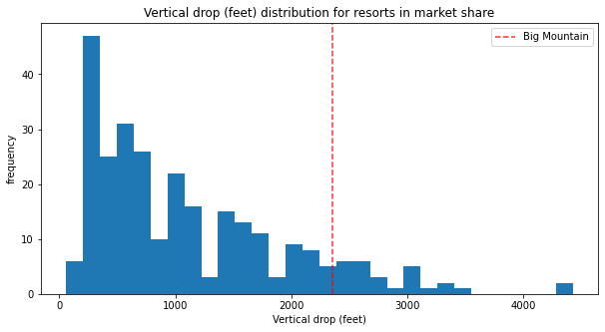
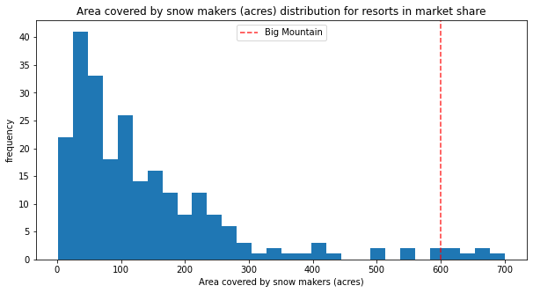
Application of the Model
Based on the current facilities present at Big Mountain Resort (BMR), the model predicts a weekend ticket price of $95.87 with an error of $10.39.
BMR outperforms most resorts on features correlated with elevated ticket prices.
There is room for ticket price increase of at least $4.48 without any site improvements.

Slide 8
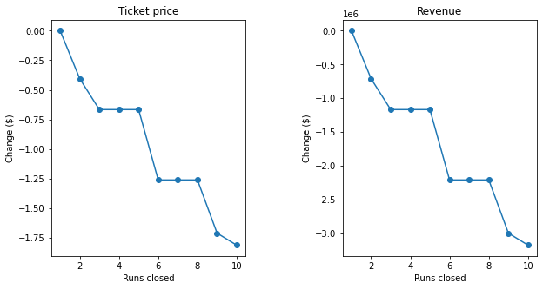
Potential Site Improvements
Closing 1 run will not impact pricing.
Closing subsequent runs will have the impact shown to the right.
Adding a run, increasing the vertical drop by 150 feet, and installing an additional chair lift will support a ticket price increase of $1.99.
Adding 2 acres of snow making in addition to the previous point will not justify a further ticket price increase.
Increasing the longest run by 0.2 miles and adding 4 acres of snow making will not justify a ticket price increase.

Slide 9
Summary & Future Considerations
How can Big Mountain Resort reduce operational costs and/or increase ticket price (revenue) so that profits increase by at least $3 million by the end of the year?
The model produced suggests that the problem statement's success criteria can be met by increasing ticket price to $95.87 in the resort's current status.
This increase would yield approx. $26 million in additional annual revenue.
An additional $1.99 increase in ticket price resulting from adding a run, increasing the vertical drop by 150 feet, and installing an additional chair lift is supported.
This would yield another $3.5 million in additional annual revenue.
Further consideration of the operating costs associated with such renovations must be considered.
A live model should be implemented to keep up to date with the market.
Customer surveys can be used and considered by the model to improve its ability to predict what a consumer will pay.

